Slide 1
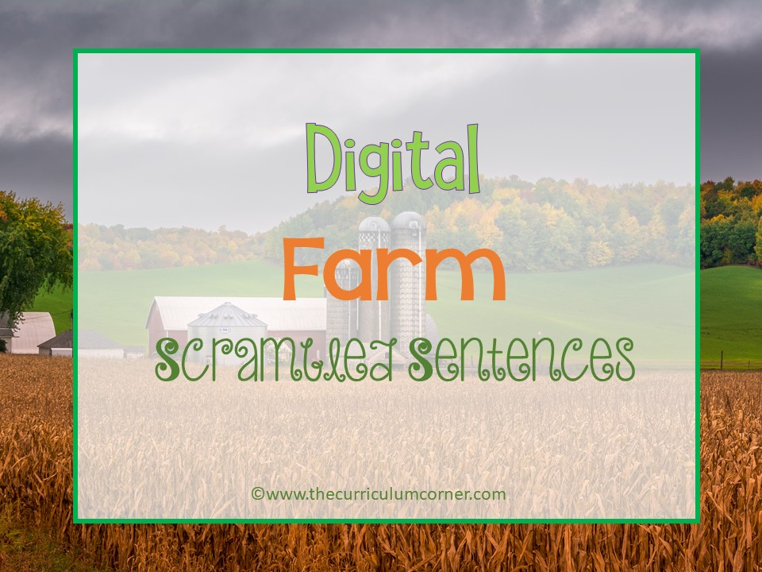

Slide 2
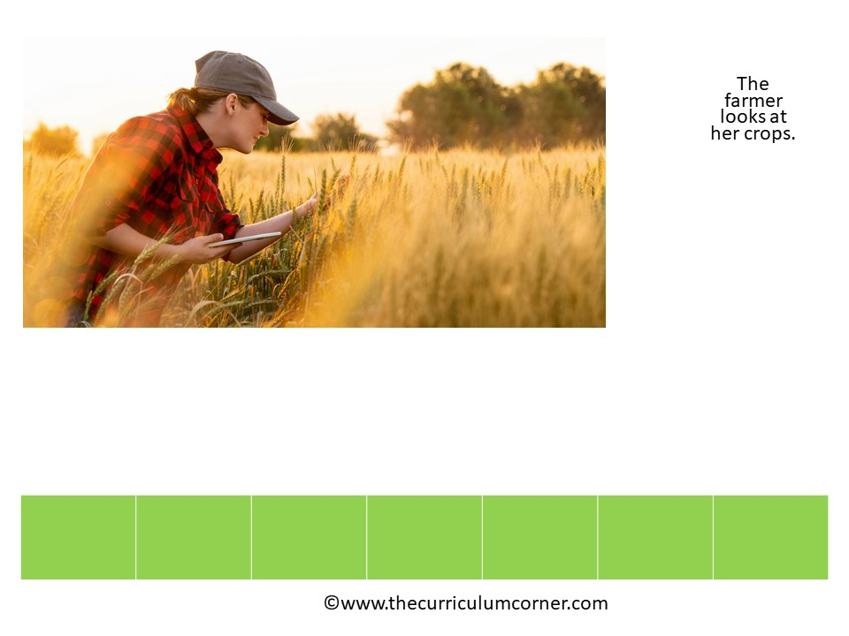

her
The
crops
farmer
at
looks
.

Slide 3
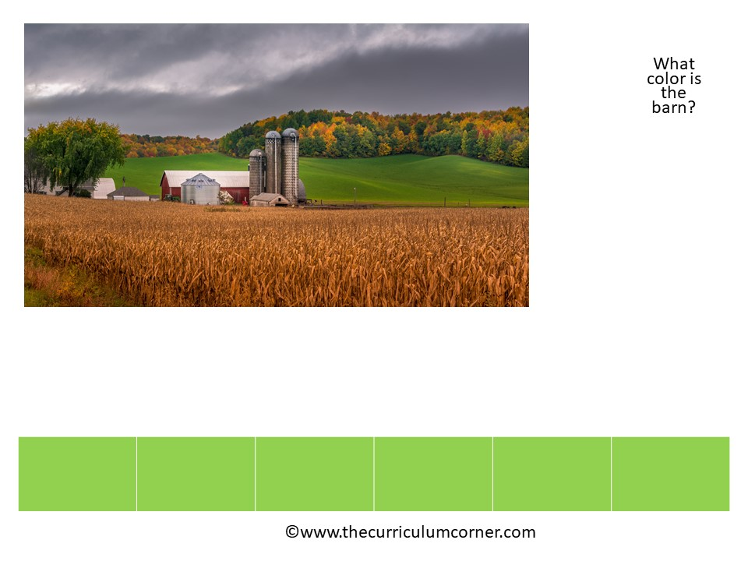
color
barn
What
?
the
is

Slide 4
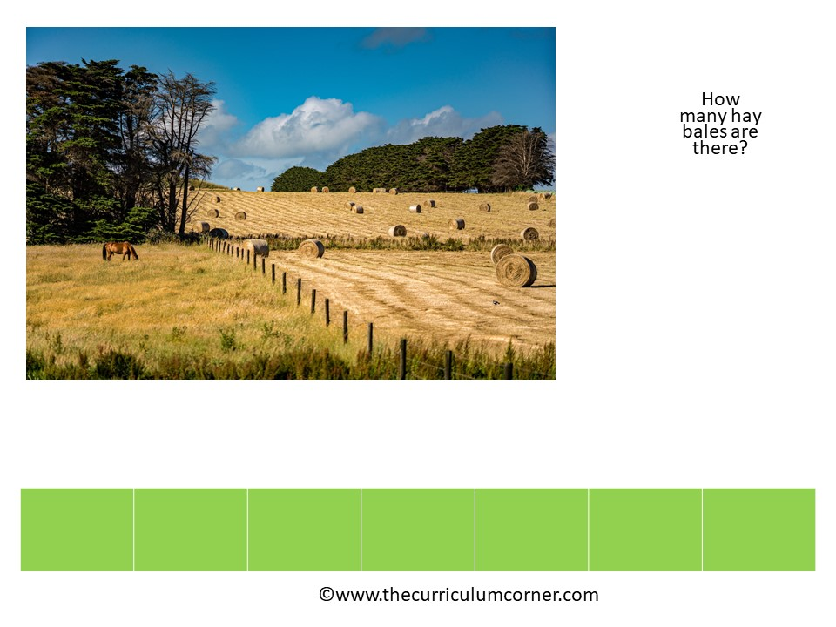
hay
How
bales
?
there
are
many

Slide 5
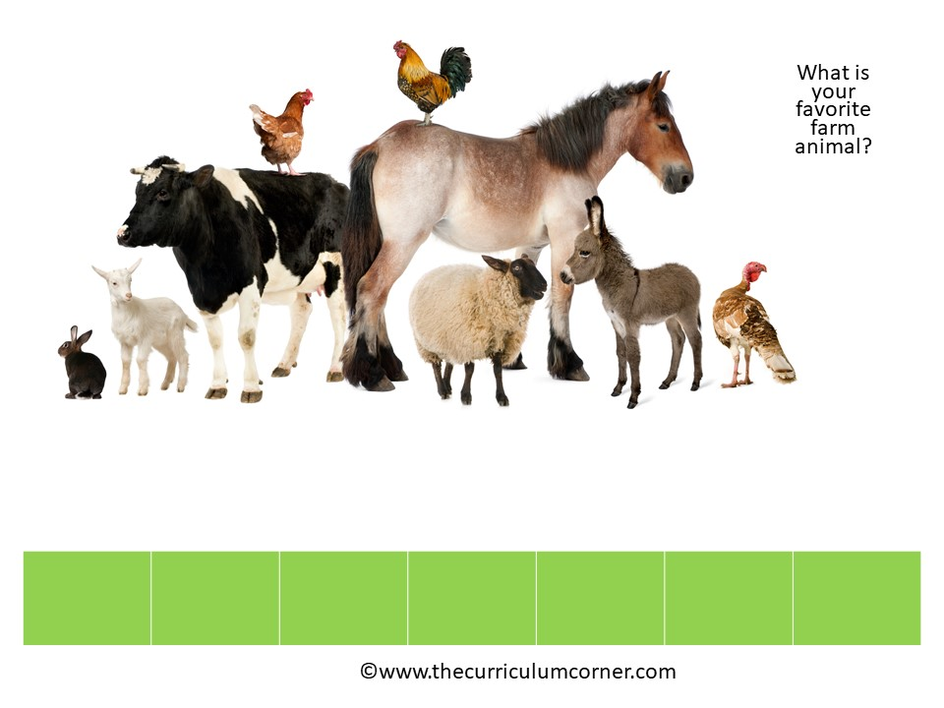
is
?
What
farm
animal
favorite
your

Slide 6
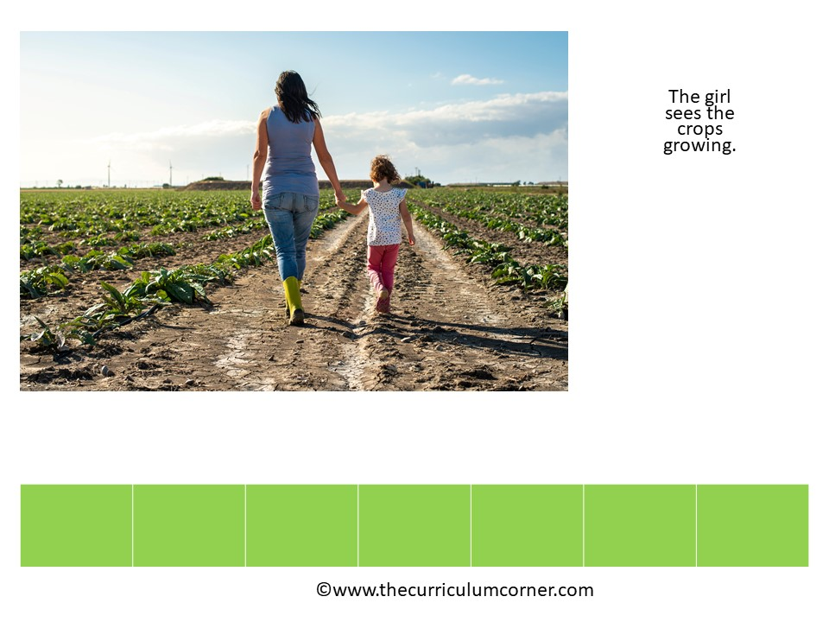
the
crops
growing
The
.
girl
sees

Slide 7
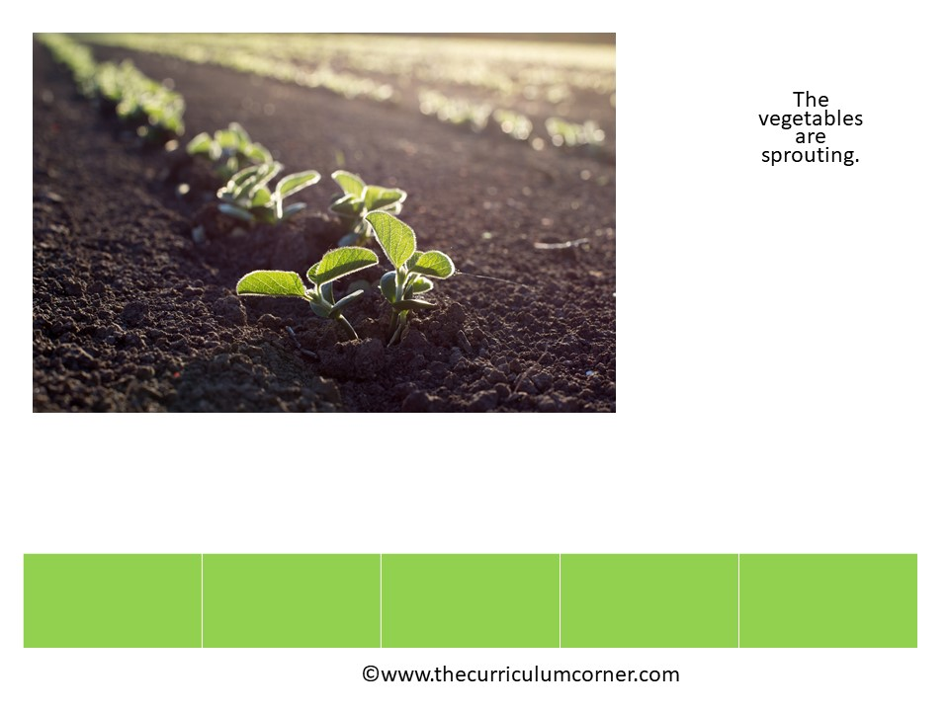
sprouting
The
.
vegetables
are

Slide 8
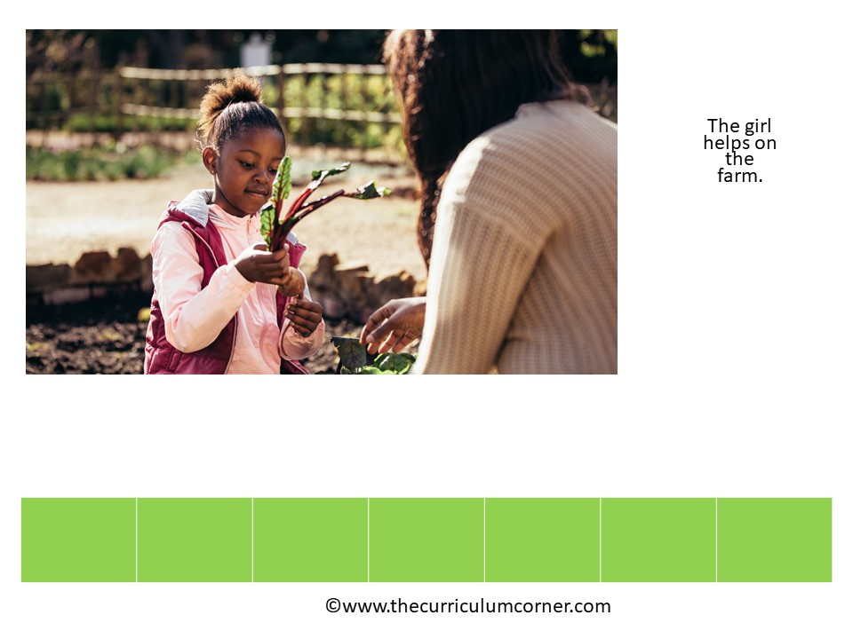
on
.
farm
The
the
girl
helps

Slide 9
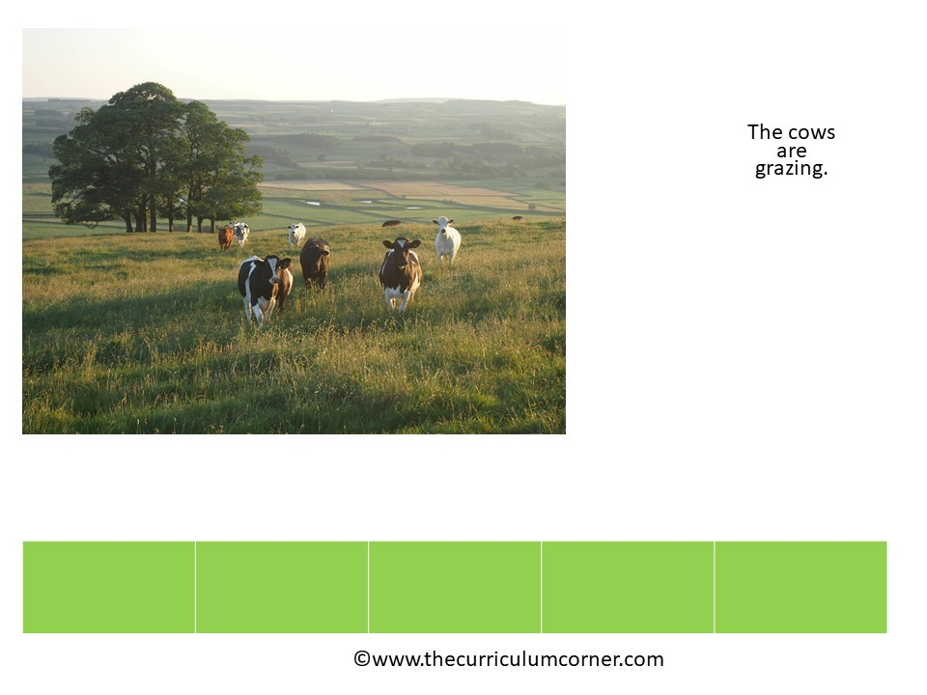
grazing
The
.
cows
are

Slide 10
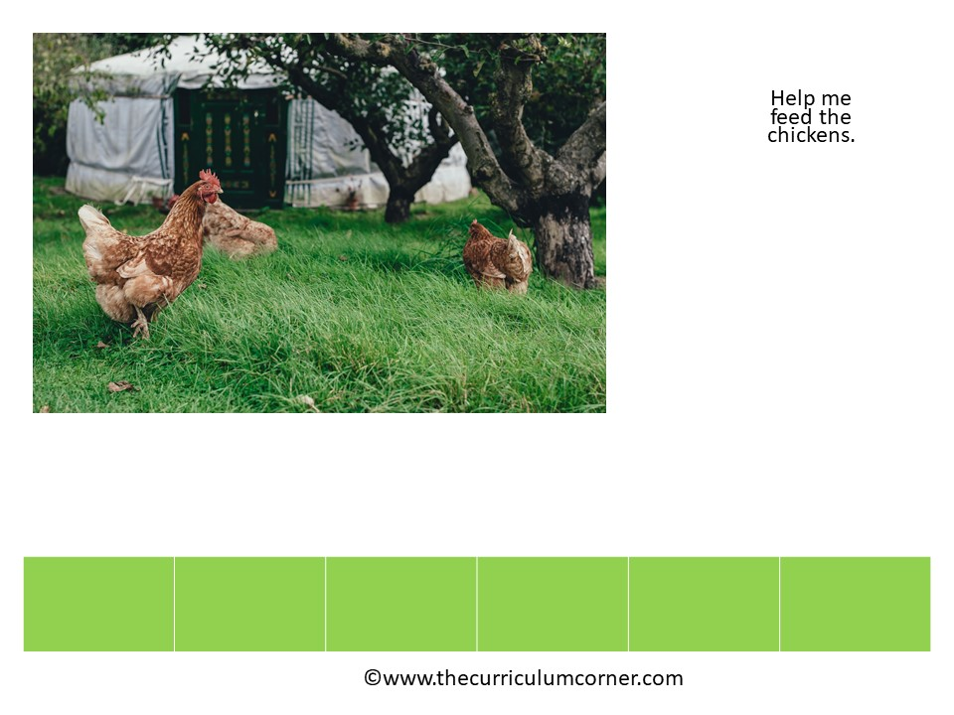
chickens
Help
.
the
me
feed

Slide 11
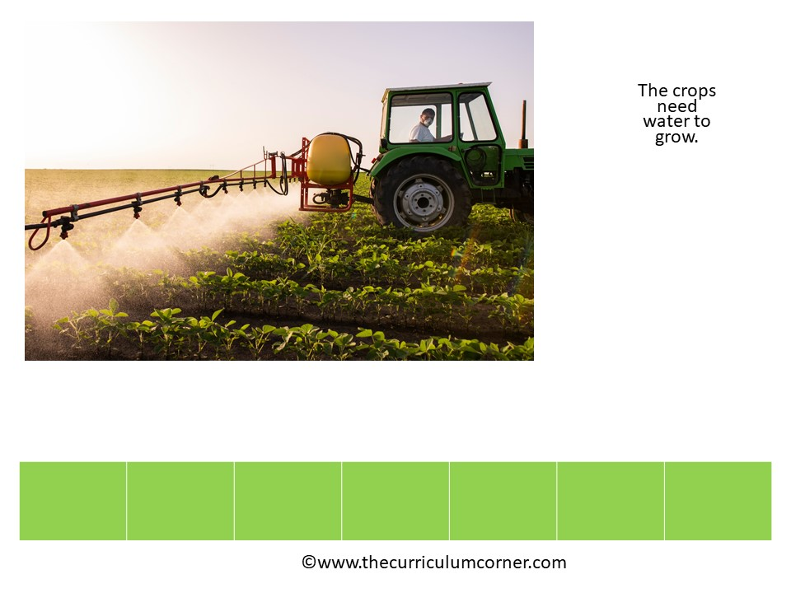
crops
.
grow
The
need
to
water

Slide 12
